Slide 1

E-Healthcare management system
SRM INSTITUTE OF SCIENCE AND TECHNOLOGY
FACULTY OF ENGINEERING AND TECHNOLOGY
DEPARTMENT OF NETWORKING AND COMMUNICATIONS
21CSC203P - ADVANCED PROGRAMMING PRACTICE
Student Reg Nos: 178, 181
Batch_Id: 20

Slide 2
Table of contents
Introduction
Motivation
Innovation idea of the project
Purpose of the project
Scope of the project
Output Screenshots
Database
8/11/2023

Slide 3
Introduction
The E-Healthcare Management System is a python-based application designed to streamline and enhance healthcare services, making them more accessible and efficient. The system aims to facilitate the management of patient records, appointments, and healthcare resources while ensuring data security and user-friendly interactions.
Introducing the E-Healthcare Management Application, a digital tool designed to consult with a doctor for a regular health check up.
This project aims on providing a streamlined and intuitive solution to health consultation in an online platform, that often accompanies modern living.
Aims to create an E-Healthcare management system that allows people to get a doctor’s consultation online, which saves time and effort in getting an appointment in person.
8/11/2023

Slide 4
Motivation
Benefits: Offers a streamlined approach to managing prescribed medicine lists and bills; and providing doctor details and patient details in an orderly manner, which is useful in booking appointments.
Time Saving: This application can save quite an amount of time and effort of standing for an appointment in person.
User Authentication and Authorization: Secure login and registration for healthcare professionals (doctors, nurses), administrators, and patients.
Productivity Boost: Focuses on getting secure appointments that enables patients to request appointments with their preferred healthcare providers.
8/11/2023

Slide 5
Idea of the Project
Centralised Healthcare Management: Users can consolidate all their appointments, prescriptions, bills in one place making it easy to access the documents.
Patient Management: Patient registration and profile management, including personal details, medical history, and insurance information.
Mobile-Friendly Interface: Develop a responsive design that allows users to access the system from various devices, including smartphones and tablets.
Reporting and Analytics: Generate reports and analytics for healthcare providers and administrators to track patient outcomes, appointment statistics, and financial performance.
8/11/2023

Slide 6
Purpose of the Project
User-Friendly Interface: Focuses on delivering a user-friendly and intuitive interface that simplifies the process of scheduling appointments and managing bills and regular medicines.
Data Security and Compliance: Ensuring the security and privacy of patient data is a fundamental purpose. The system complies with healthcare data security regulations (e.g., HIPAA in the United States) to protect sensitive medical information.
Efficient Healthcare Resource Management: By digitizing and centralizing patient records, appointments, and healthcare resources, the system improves the efficient use of healthcare facilities and professionals, reducing administrative overhead and resource wastage.
Real-World Application: Healthcare is a fundamental aspect of daily life for every individual today and we believe this initiative would be useful in having an eye on one’s well being.
8/11/2023

Slide 7
Scope of the Project
Minimalistic Design: The application will have a straightforward and minimalistic design to focus on core functionalities.
Single User Focus: The application will be designed for individual use and won't include features for collaborative health management.
Integration with Healthcare Systems: Integrate with other healthcare systems and databases to access and update patient data securely.
User Roles and Access Control: Define and implement user roles, such as patients, healthcare professionals (doctors, nurses), and administrators, each with specific access privileges.
8/11/2023

Slide 8
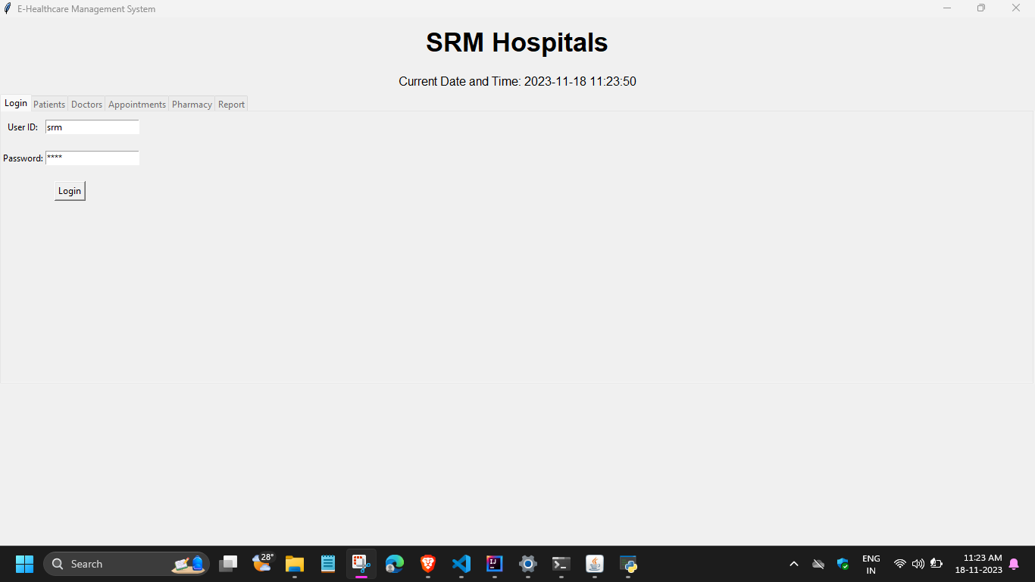
Output Screenshot

Slide 9
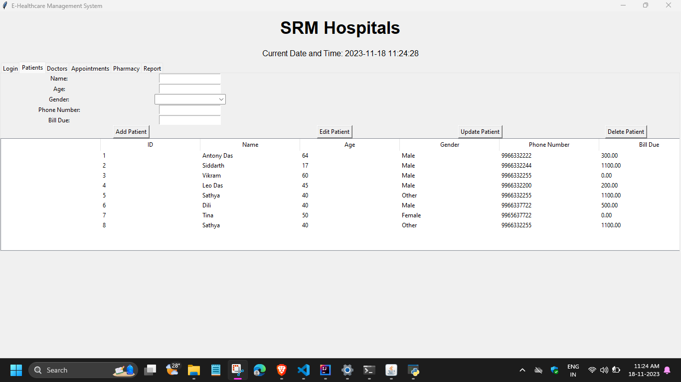

Slide 10
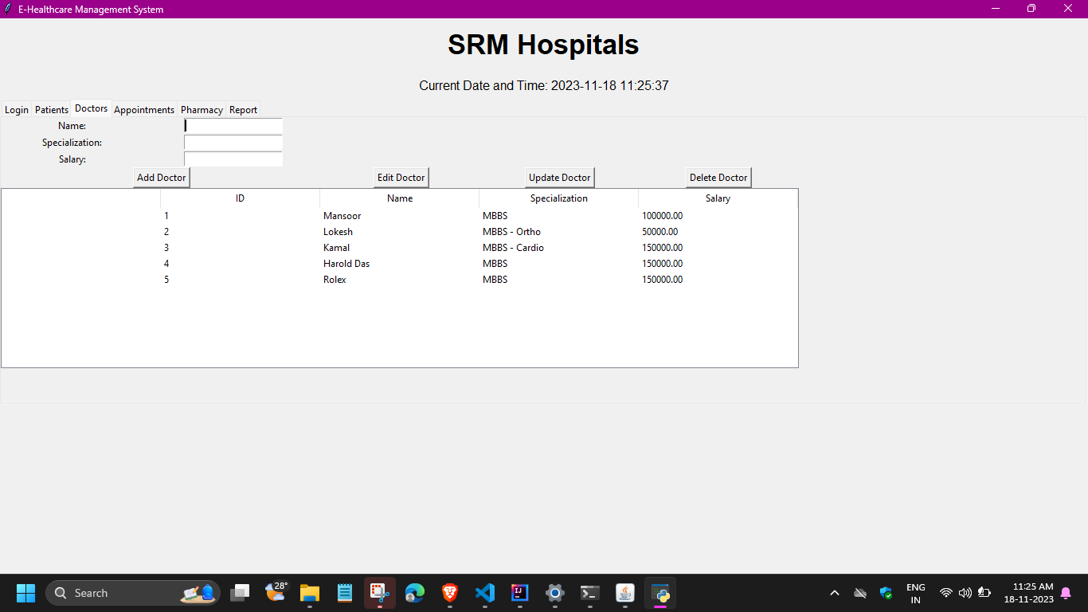

Slide 11
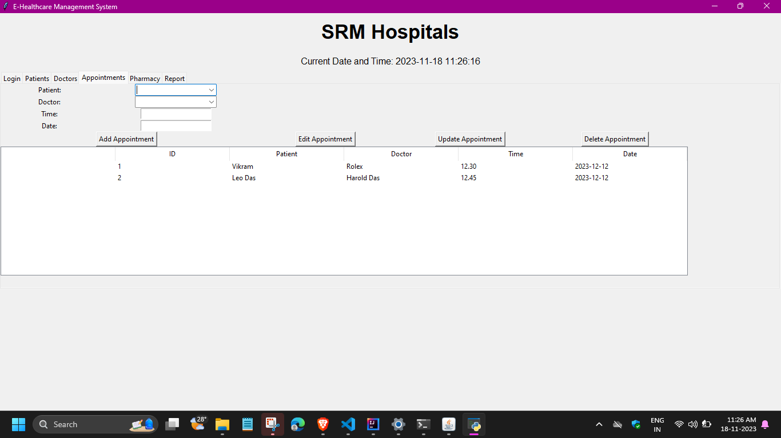

Slide 12
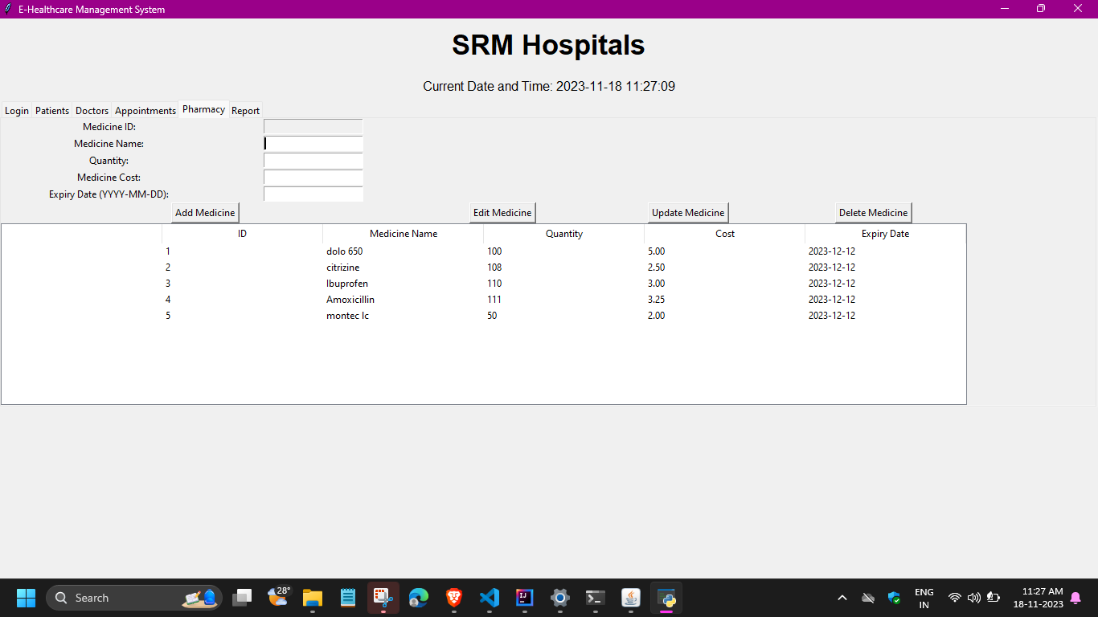

Slide 13
